Slide 1
Volunteers’ Management System
Apollo Group
Abdullah Arslan
Abdollah Tabareh
Gilana Ramezani
Mustafa Al-Zubaidi
Shobha B C
Tigran Harutyunyan
Waseem Soomro

Slide 2
Agenda
Process (RUP/AUP Milstones and Documents)
Overall structural diagram
Overall Scenario
One specific scenario
Features
Imported features+ usecases
Non functional req
Architectural diagram
Feature plan and extension to the project
Summary
Questions?

Slide 3
Background
Problem
No focus on the citizen
Citizens were not part of the crisis
IT systems were not focused on the citizens
Training programs and membership were hard
Trust
Solution
Major focus is on citizen
Parfect IT system
No formal training is needed
Trusted

Slide 4
Process
Started with AUP, but gradually shifted towards its parental process RUP.
The templates and the documents are provided based on RUP, to meet the course expectations.
Milestones | Documents
Mid-Inception | Problem Statement Initial state of Vision Document
Inception | Vision Document Project Plan Risk Mitigation Plan Quality Assurance Plan
Mid- Elaboration | Use Cases Activity Diagrams Screen Mockups Supplementary Specification Document
Elaboration | Software Requirement Specification document Final Report

Slide 5
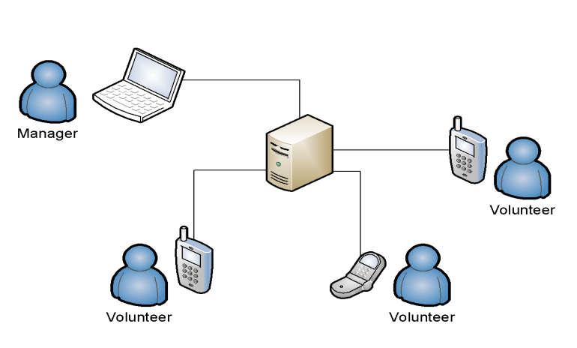
Overall structural diagram

Slide 6
Overall Scenario

Slide 7
One specific scenario

Slide 8
Features
REGISTRATION AND MEMBERSHIP
PROFILE MANAGEMENT
RESOURCE MANAGEMENT
INCIDENT MANAGEMENT
INFORMATION GATHERING
    REPORTING NEW INCIDENTS
    REPORTING THE STATUES OF THE EXISTING INCIDENTS
COMMUNICATION
    WARNING THE USER
    SEND REQUEST FOR THE HELP
LOG ANALYSIS AND BACKUP

Slide 9
RESOURCE MANAGEMENT
Semi-automatic
Assists the crisis manager for resource management for selecting the volunteers.
On bases of crisis nature and severity of the crisis

Slide 10
Use Case Name | Create Request
Description | Manager creates and sends a request related to an active incident.
Actors | Manager
Identifier | UC 06
Pre-conditions There is an active incident Crisis Management main page is opened
Post-conditions Automatic request sending is started. The data and actions are logged in the system.
R06-1 Main Path Manager finds volunteer refer to Search Volunteers use-case And selects the incident from the list of incidents System shows information and options for the incident Manager selects “Create Request” option System shows Create Request Page Manager fills the form and sends request: Enters a message to the volunteers Presses ‘Send request’ button. 6. System saves and sends the Manager’s massage with the incident need list, incident location to the Mobile Application and navigates to Crisis Management main page.
Alternate paths R06-2 In step 5, Manager presses the ‘Cancel’ button. Then system ignores this dialog and returns to Crisis Management main page.
Non-Functional
Issues

Slide 11
Non- functional Requirements
Quality attributes are based on ISO 9126 software quality standard
Accuracy
Interoperability
Security
Reliability
  Maturity
  Fault tolerance
Usability
  Learnability
  Learnability
  Operability
Efficiency
  Time behavior
  Resource utilization
Maintainability
  Analyzability
  Changeability
Portability
  Adoptability
  Installability

Slide 12
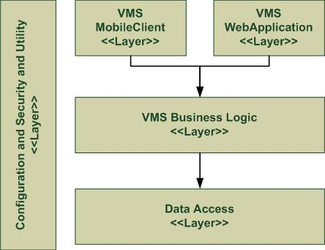
Architectural diagram

Slide 13
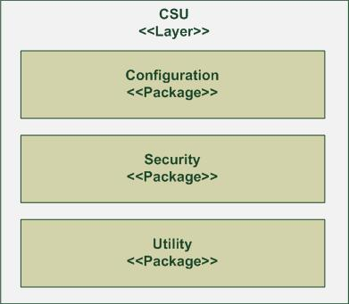
Configuration, Security & Utility

Slide 14
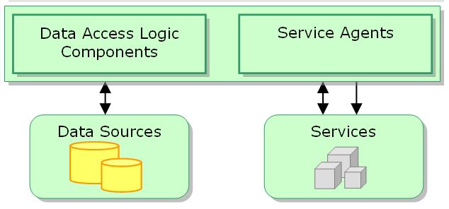
Data Access Layer

Slide 15
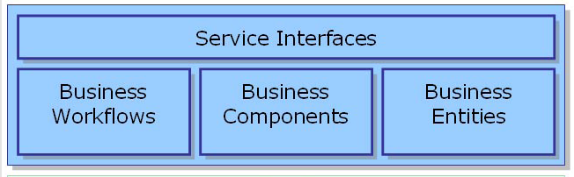
Business Logic Layer

Slide 16
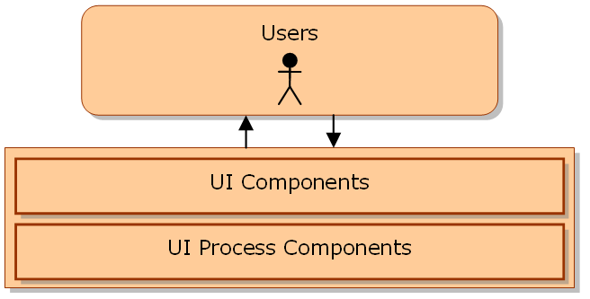
VMS mobile client

Slide 17
VMS web application

Slide 18
Future plan & extension to the project
Plan
Realizing these specifications in technical challenge course.
Extension
This project is just a general idea which can be customized for organizational specific requirements.
This can be extended to the trained members to manage as well
This can be linked to the real world system which can facilitate the information flow.

Slide 19
Summary

Slide 20
Questions?

